Slide 1
New Billboard Generation With Computer Vision
Doan Kieu

Slide 2
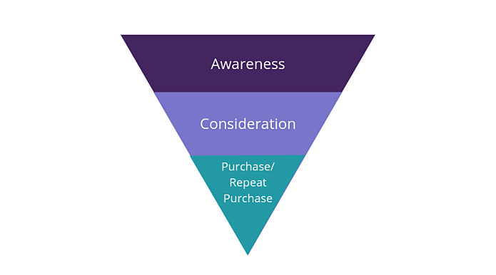
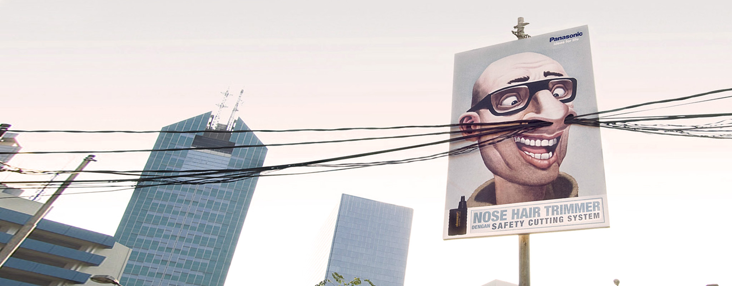
Brand Awareness

Slide 3
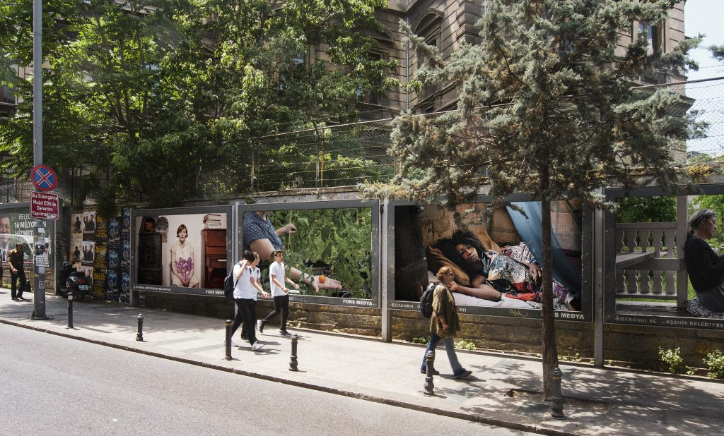
Billboard Advantages
+ Reach 78% of Australians notice Outdoor Advertising each month.
+ 88% say brands on billboards stand out.
+ 46% of people believe Billboards bring new products to their attention.

Slide 4

Billboard Disadvantages
Difficult To Targeted
Cost: $1200 to $10,000 a month or more.

Slide 5
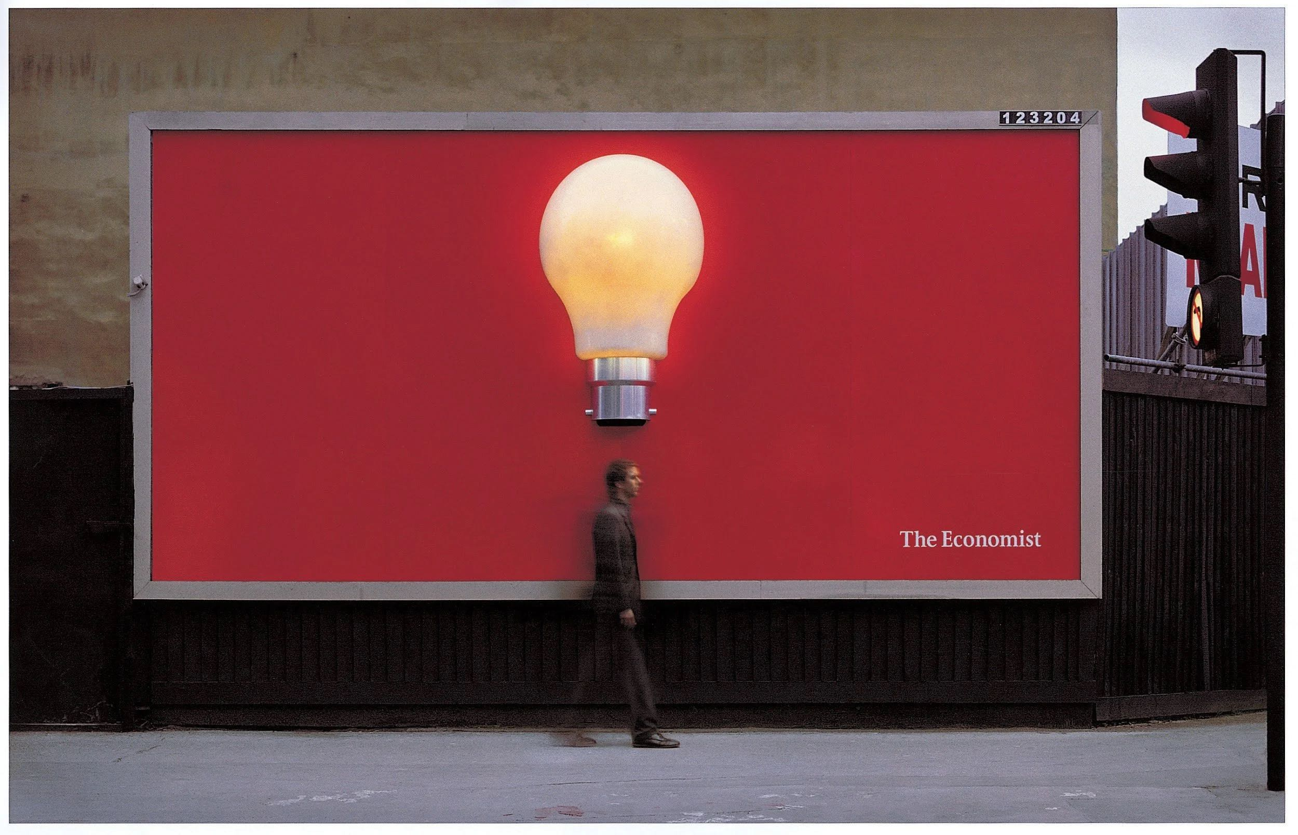
New Generation Of Billboard can measure:
+ Traffic
+ Impression
+ Engagement
+ Demographic

Slide 6
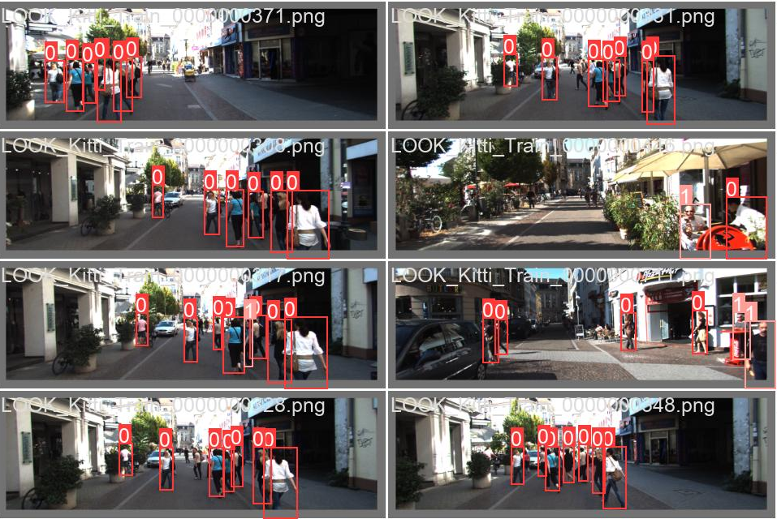

Slide 7
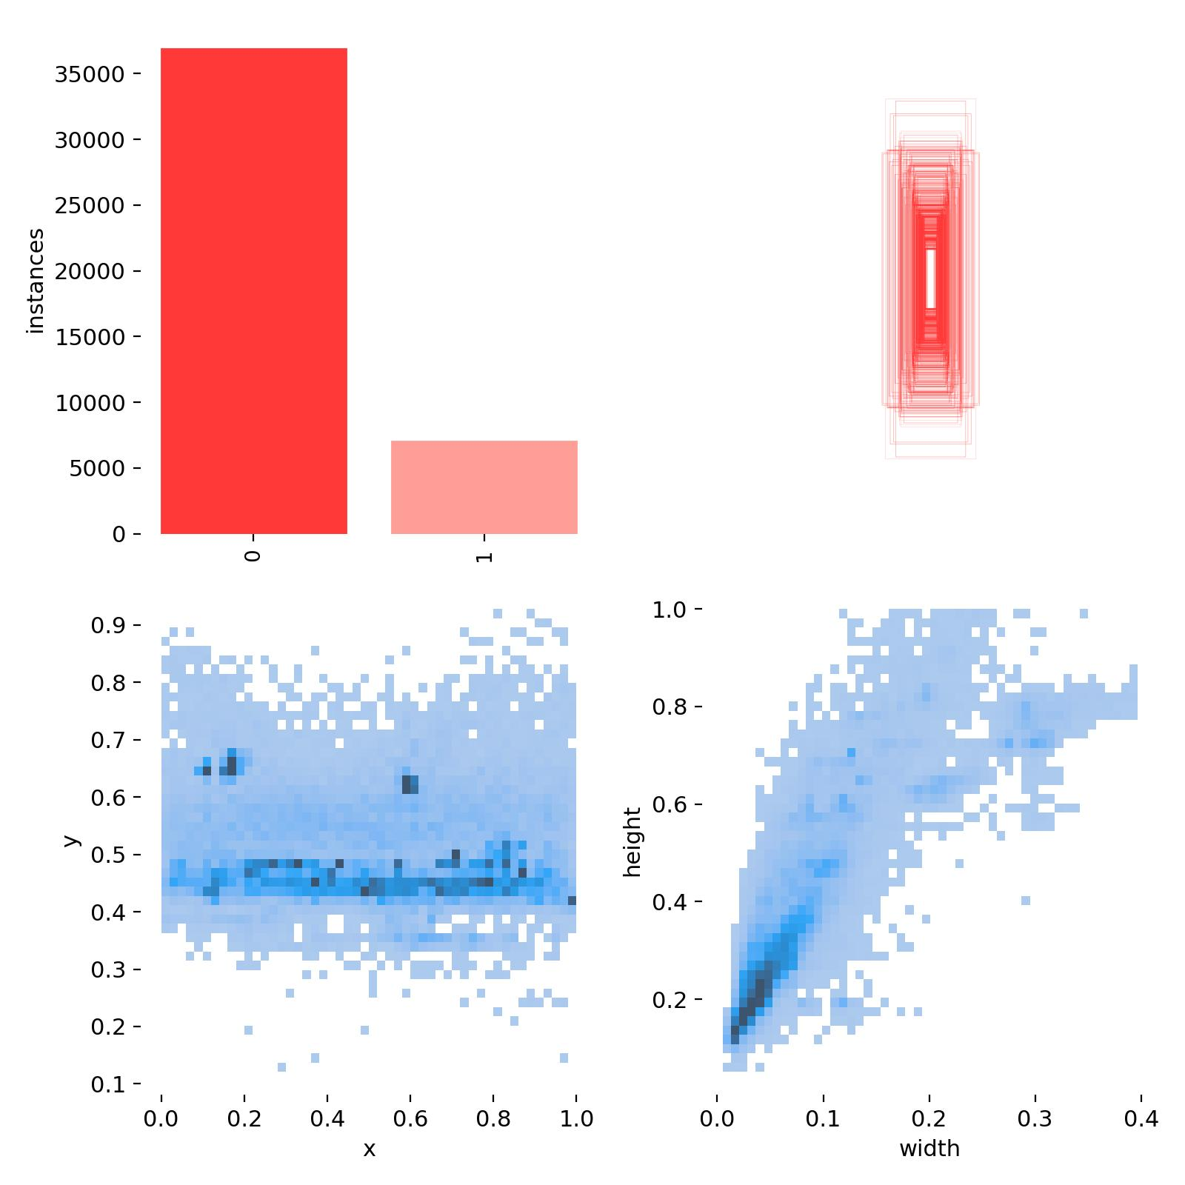
Imbalace Dataset
Small Objects locate in the middle of the frame

Slide 8
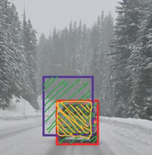
YOLO v5
Superb Speed
IoU = Intersection over Union
Area of yellow box
/ Area of green box

Slide 9
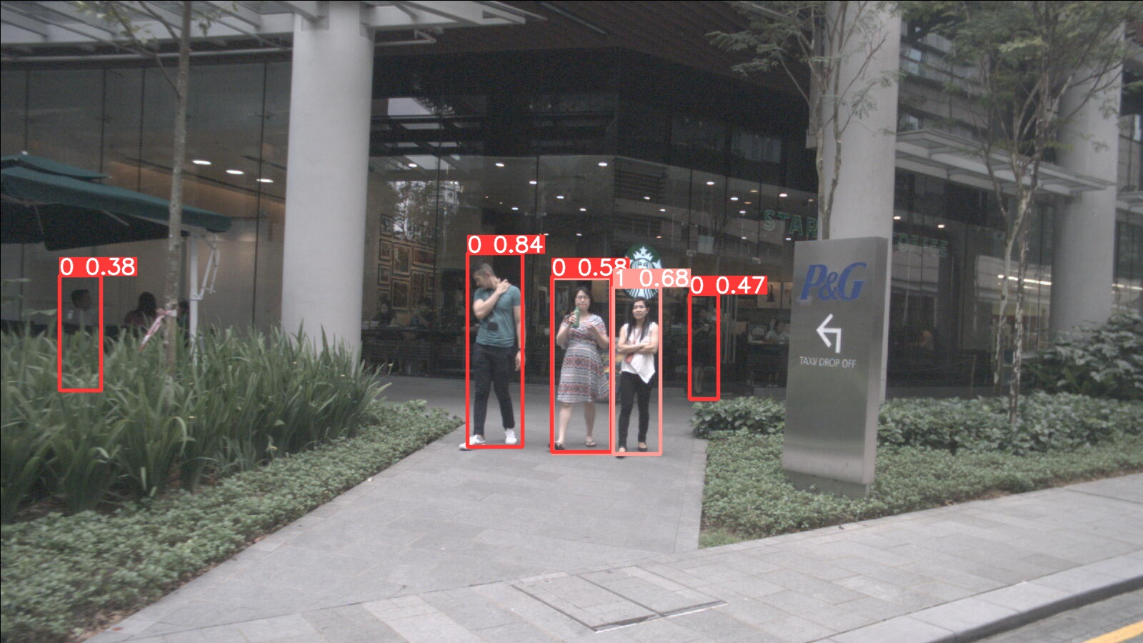

Slide 10
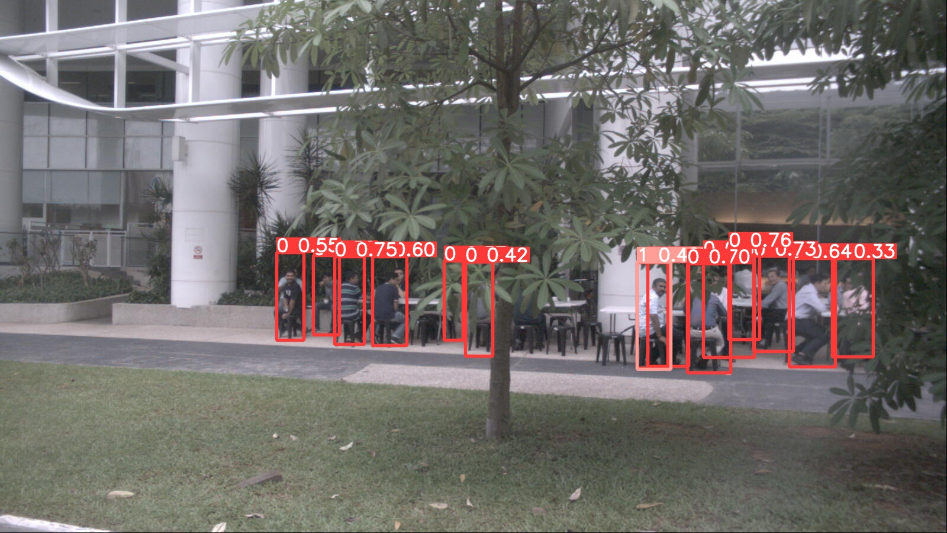

Slide 11
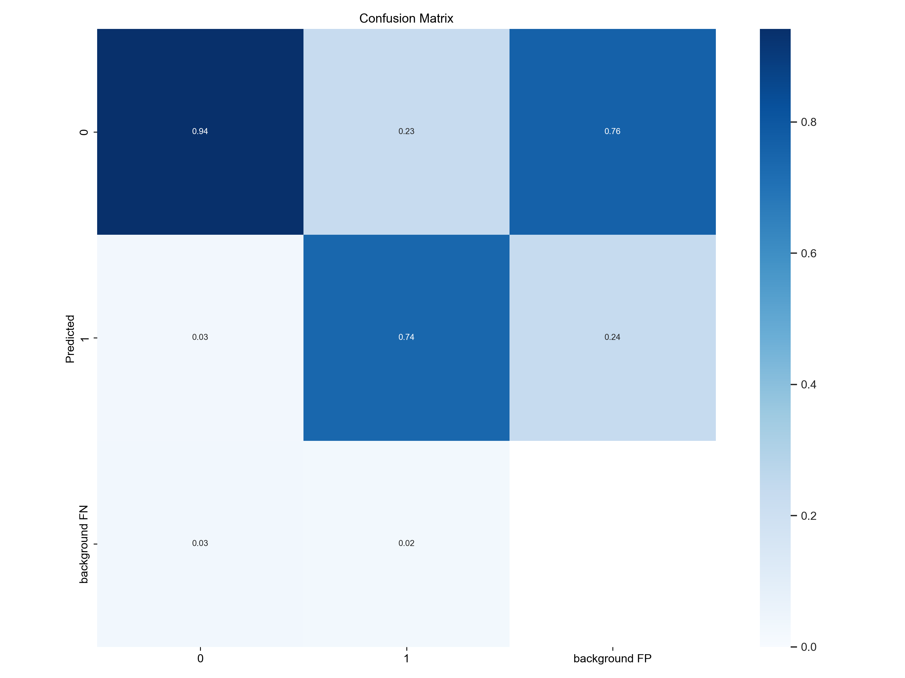
CONFUSION METRIC
+ Good False Positive Rate is low. Fairly charge customers by impression
+ High False Negative Error which can be rectified at quote
+ Background prediction error won’t be an issues

Slide 12
Limitations & Improvement
Imbalanced dataset handling techniques
Computation capacity: (10 epoch)
Impression in frame vs impression in live video
Camera Range
Various Conditions
Security issues
Licences & Permits

